Slide 1
Datathon – GS Challenge

Slide 2


Hey stickman, I would be glad to help. So stick around (no pun intended) for some good old data.
Hey buddy, I need your help.
I want to open a Mexican restaurant/truck. I have so many questions. Please help me by using your data-powers
Goldy
Goldy’s friend

Slide 3
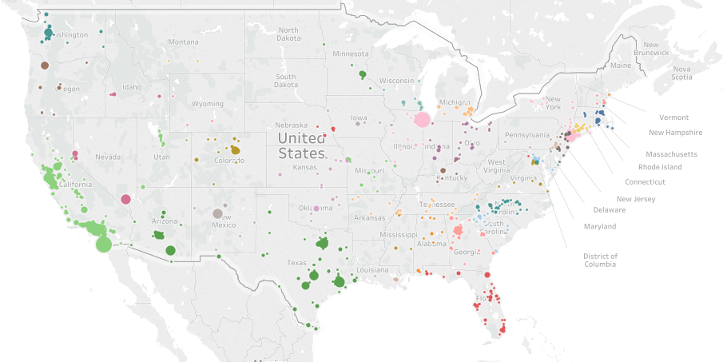
1. Where to open a restaurant
You see the big bubbles in the graph, stickman. Those show the density of authentic Mexican restaurants, which shows a high demand of Mexican food in those regions

Slide 4
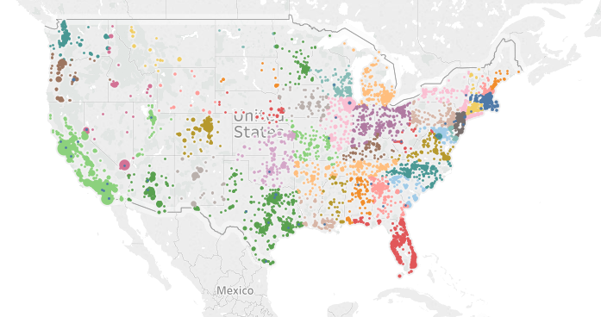
Cont.
This graph shows all the restaurants serving Mexican food along with other cuisines (including authentic Mexican restaurants). So you see, Stickman, number of authentic restaurants are still parse. So you definitely would want to open up an authentic Mexican restaurant

Slide 5
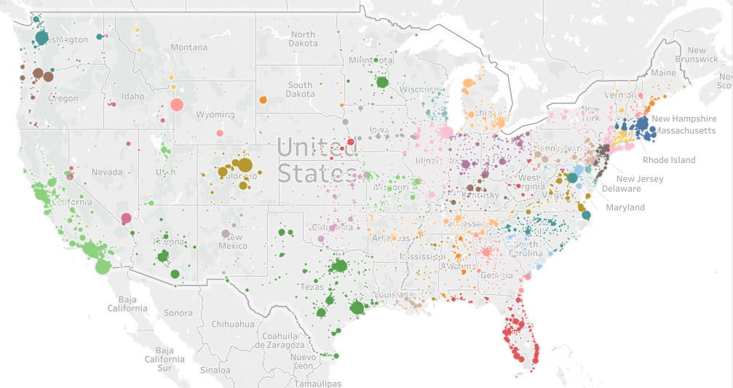
Restaurants per capita (per 10k)
This map shows Mexican restaurants per 10k people (by city). Stickman, this is your chance to open that restaurant where there are less number of restaurants per capita. So by using this, you would be taking a very strategic decision. Its all about numbers

Slide 6
Cont.
Here are some hard numbers for you to look at, Stickman. These are the cities where population is high enough but restaurants per capita is very low. Also look at “Carmel By The Sea”, a huge tourist attraction, and a very low population. You should consider that location as well
City | Restaurants per capita | Population
Tempe | 4 | 56,722
Boulder City | 1 | 15,065
Carmel By The Sea | 12 | 3281
Alameda | 2 | 60,212
Colorado Springs | 4 | 33,822
Cupertino | 0 | 60,717
Redwood City | 4 | 32,579

Slide 7
2. Know your competition
These are the top restaurants that you will be competing with, who have a great brand value and have loyal customers. So you would want to definitely keep an eye out on of these restaurants. Your food and service will be in competition with the same of those restaurants. Give me some more time, Stickman, and I will dig up on this and get back to you.
Name | Number of restaurants nationally
Chili’s Grill & Bar | 53
El Pollo Loco | 36
Baja Fresh Mexican Grill | 24
Rubio’s | 21
Taco Bell | 16
Taco Casa | 7
Taco Del Mar | 6

Slide 8
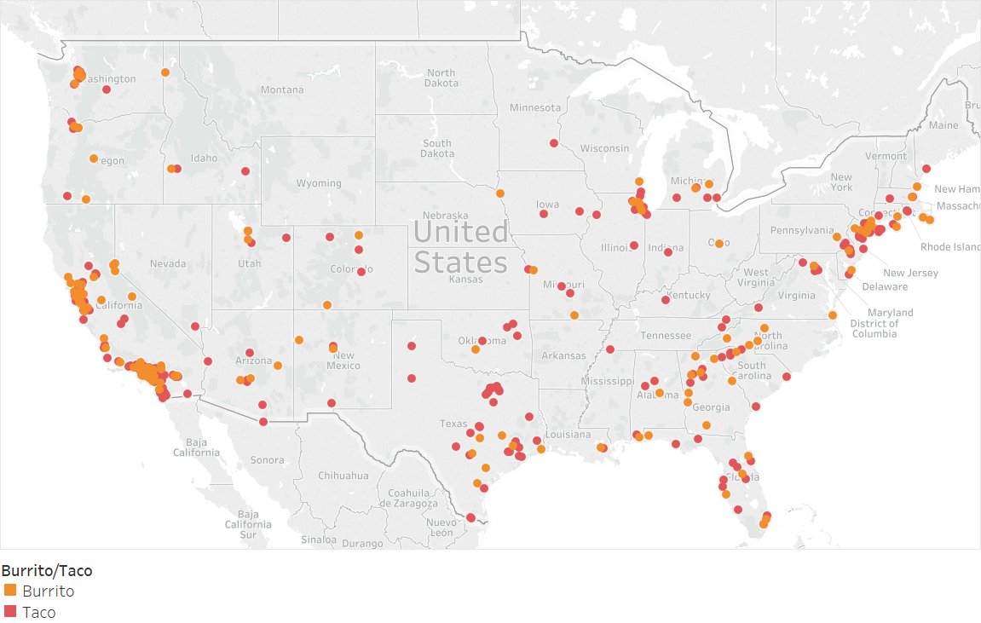
3. Menu items to offer
Now you have to decide what items to offer on the menu. Look at this map which shows the distribution of burrito vs taco over the country. So depending on your location, you would want to offer the food items accordingly.

Slide 9
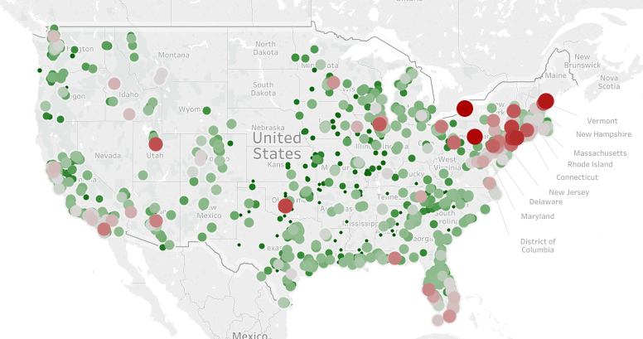

4. Price of food
Now look at the average price of menu items in Mexican restaurants across the nation. Your prices should be competitive enough to survive in this market.

Slide 10
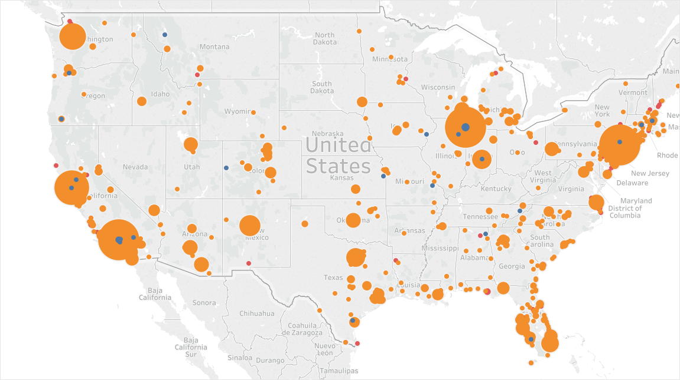
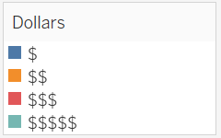
Cont.
This graph gives you an idea of price range of various restaurants throughout the country. So charge for the food accordingly.

Slide 11
I got you buddy. I left my support vectors and decision trees at home. Give me a day and you shall have your result. In the meantime, do ponder over the information I gave you and decide where can you open a new restaurant. By the way, you owe me a Burrito!!
This is great information Goldy. Thanks for your help. But I also wanted to know which are the most ordered items, which items go well with others, etc. So as to prepare my menu accordingly

